Slide 1
CROWDFUNDING DATA ANALYSIS AND VISUALIZATION
A COMPARATIVE STUDY USING EXCEL, POWER BI, TABLEAU AND SQL
By
Preksha S

Slide 2
INDEX
Project Summary.
Data Preparation.
Data Model.
Challenges faced.
Projects Overview KPIs.
Successful Projects.
Top Successful Projects.
Percentage Success Analysis.
Dashboards.
Key Take aways.
Conclusion.

Slide 3
Project Summary
Dataset: 3.6 lakh crowdfunding projects.
Aim: Clean, model, analyze KPIs on success & funding.
Key focus: Project outcomes, funding success %, top projects, category/location analysis.

Slide 4
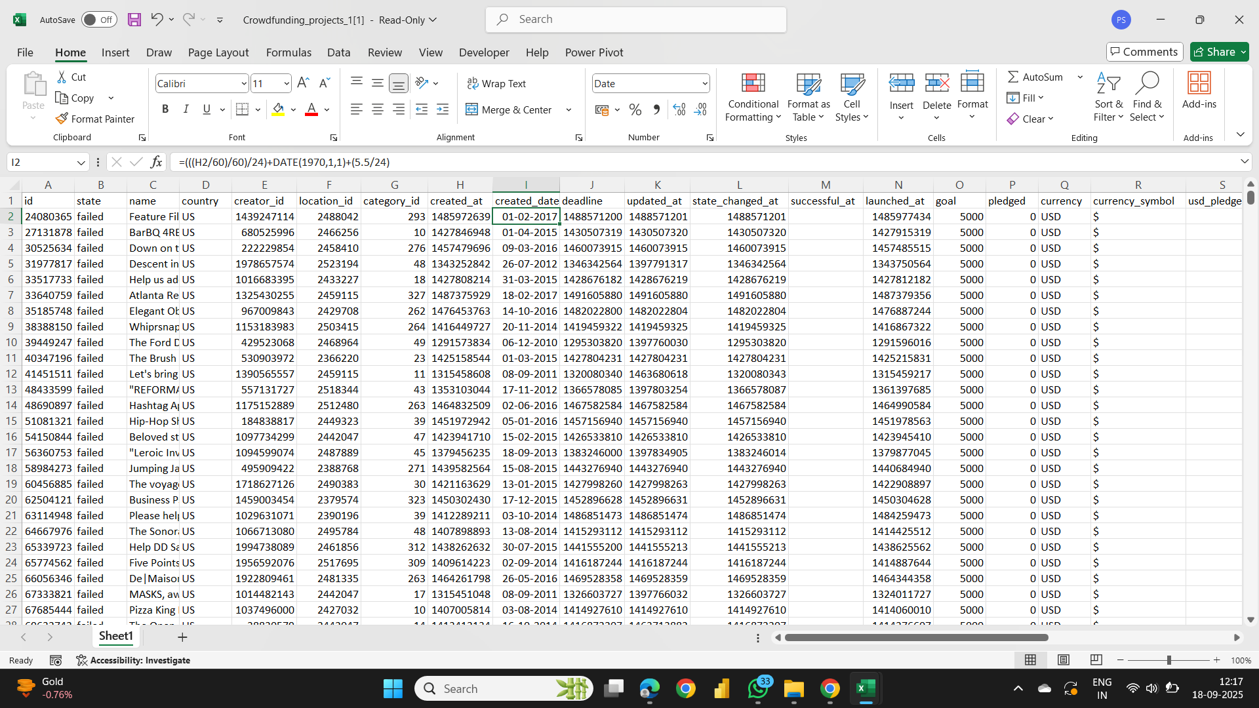
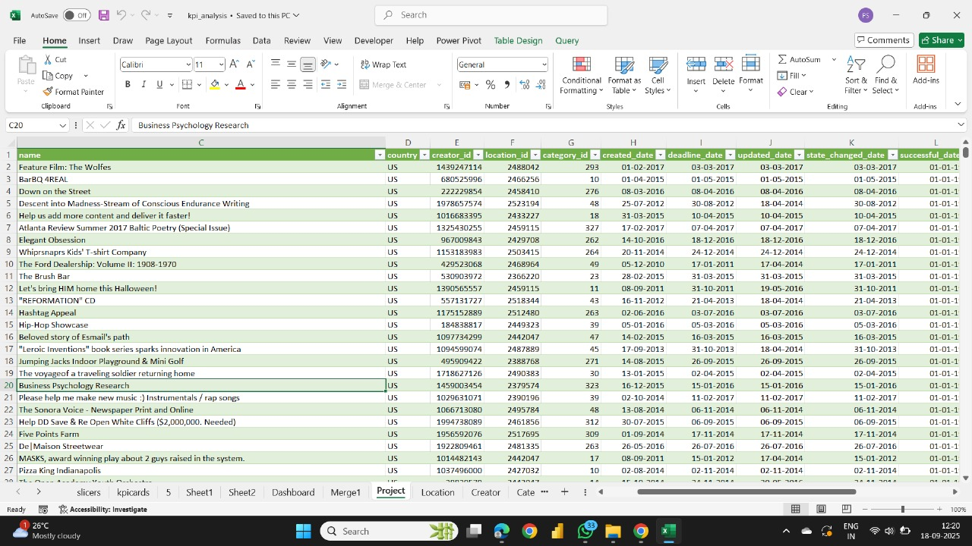
Data Preparation
Converted Epoch dates → Calendar dates.
Handled missing Creator/Location as Unknown
Removed duplicates & nulls.

Slide 5
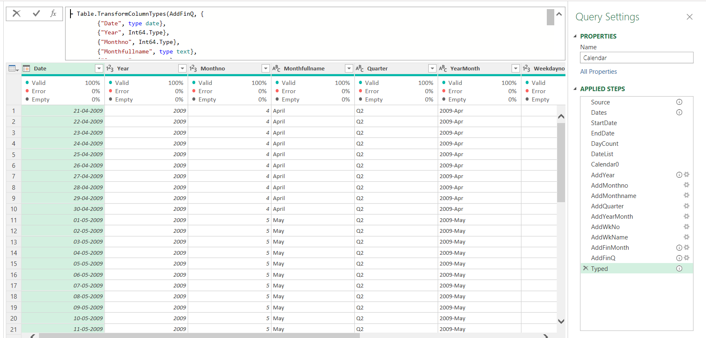
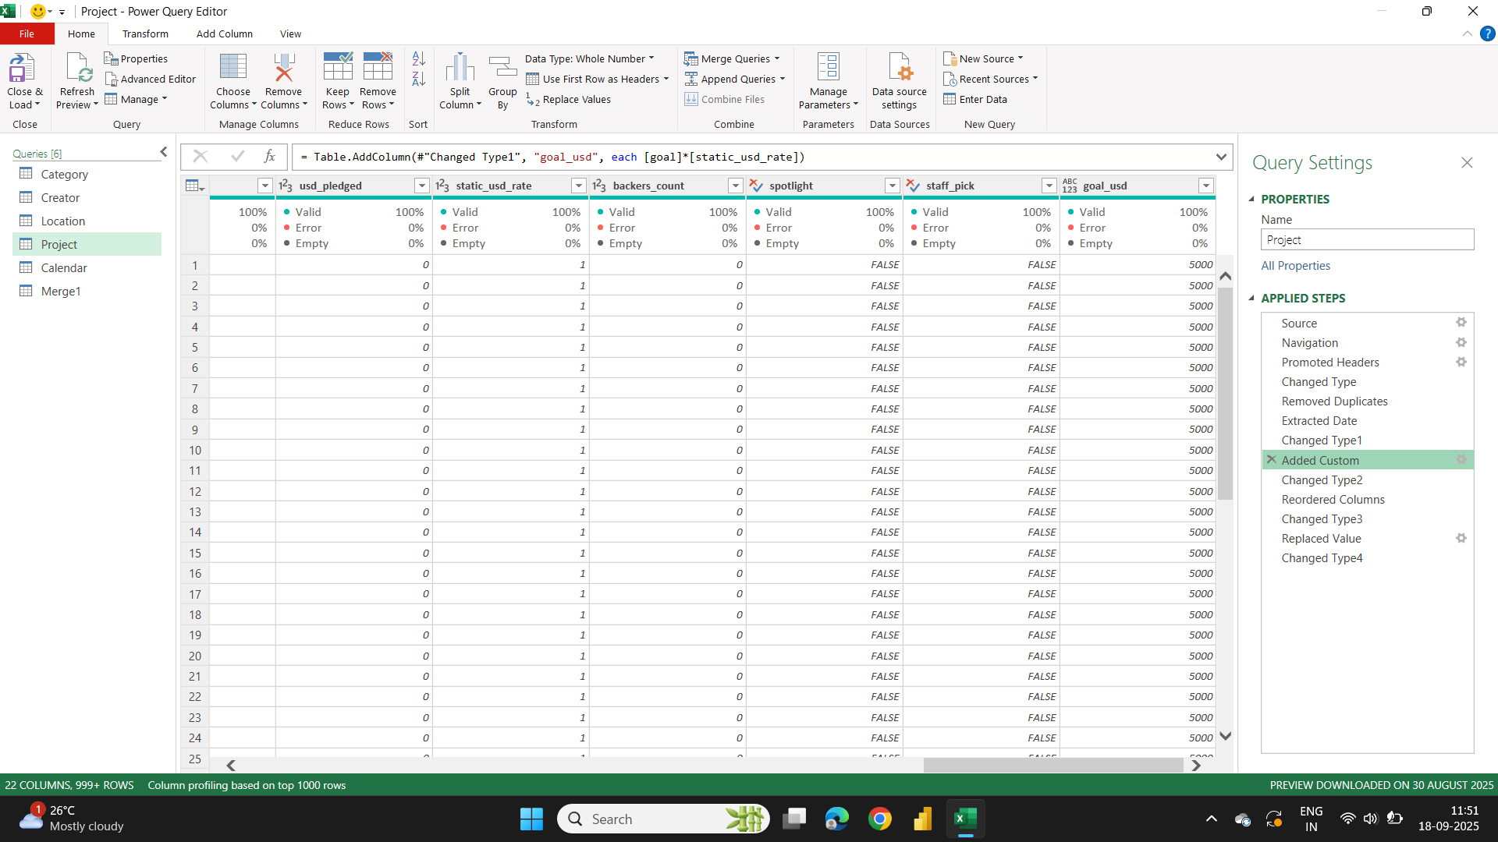
Data Preparation
Built Calendar Table with Year, Month, Quarter, Financial Year.
Converted all Goal amounts → USD using static conversion rate.

Slide 6
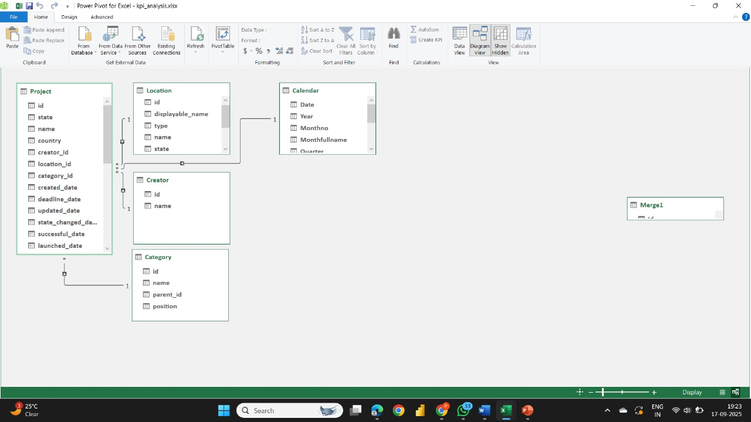
DATA MODEL
Fact Table: Project
Dimension Tables: Category, Creator, Location, Calendar
Relationships:
Project[category_id] → Category[id]
Project[creator_id] → Creator[id]
Project[location_id] → Location[id]
Project[Created_date] → Calendar[Date]

Slide 7
CHALLENGES FACED
Epoch time conversion errors.
Currency mismatches (multiple currencies → static USD).
Null/Deleted creators and locations.
Sorting Goal Ranges correctly.
Formatting KPIs with M, B, K suffixes.

Slide 8
Crowdfunding Project KPIs
📊 Projects Overview KPIs - Projects by Outcome - Projects by Location - Projects by Category - Projects by Year/Quarter/Month
💰 Successful Projects KPIs - Amount Raised (USD) - Number of Backers - Avg Duration (days)
🏆 Top Successful Projects KPIs - Top by Backers - Top by Amount Raised
✅ Success % KPIs - Overall Success Rate - Success % by Category - Success % by Year/Month - Success % by Goal Range

Slide 9
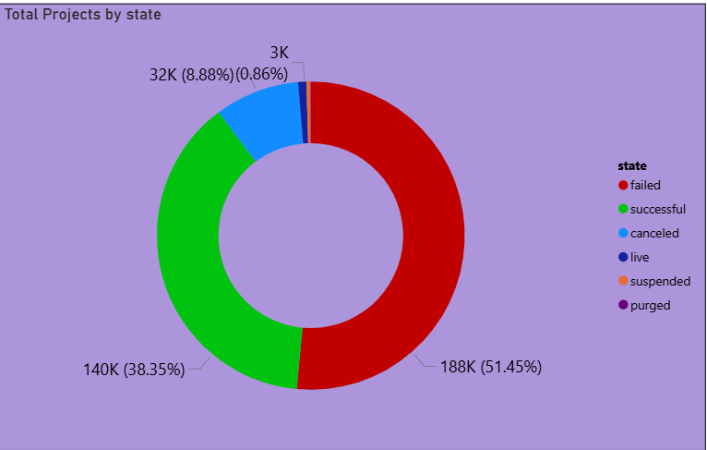
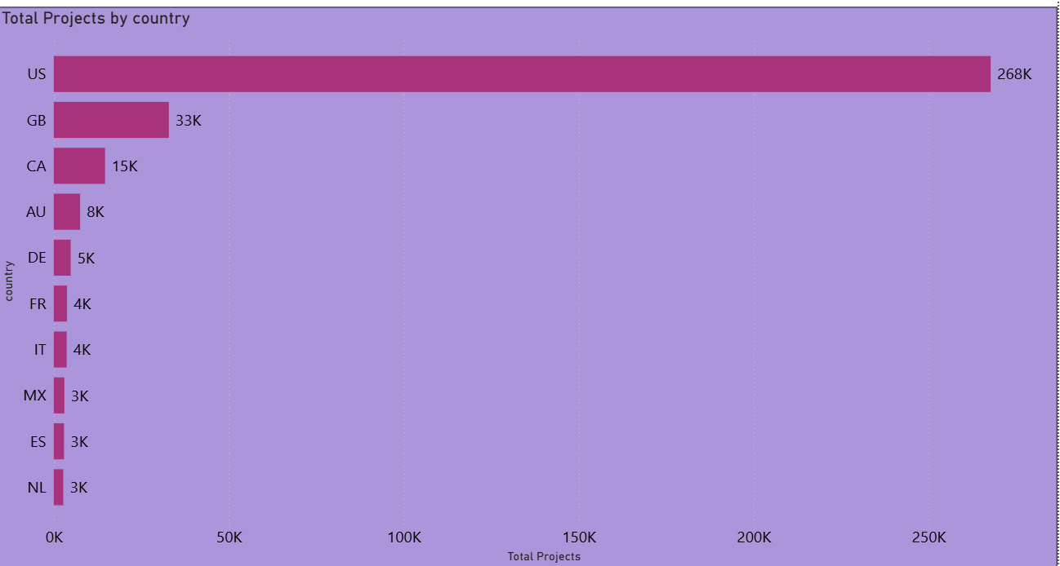
PROJECTS OVERVIEW KPIS
Total Projects by Outcome → Donut Chart
Most projects failed, with success rates well below 40%.
Successful projects formed only a small share of total campaigns.
Total Projects By Location → Column Chart
The US dominated, contributing the majority of campaigns.
Other countries had far fewer projects in comparison.

Slide 10
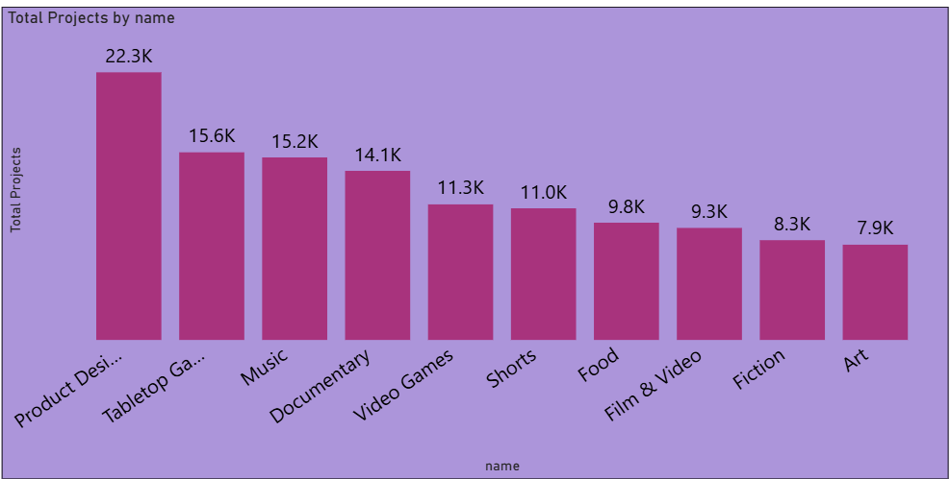
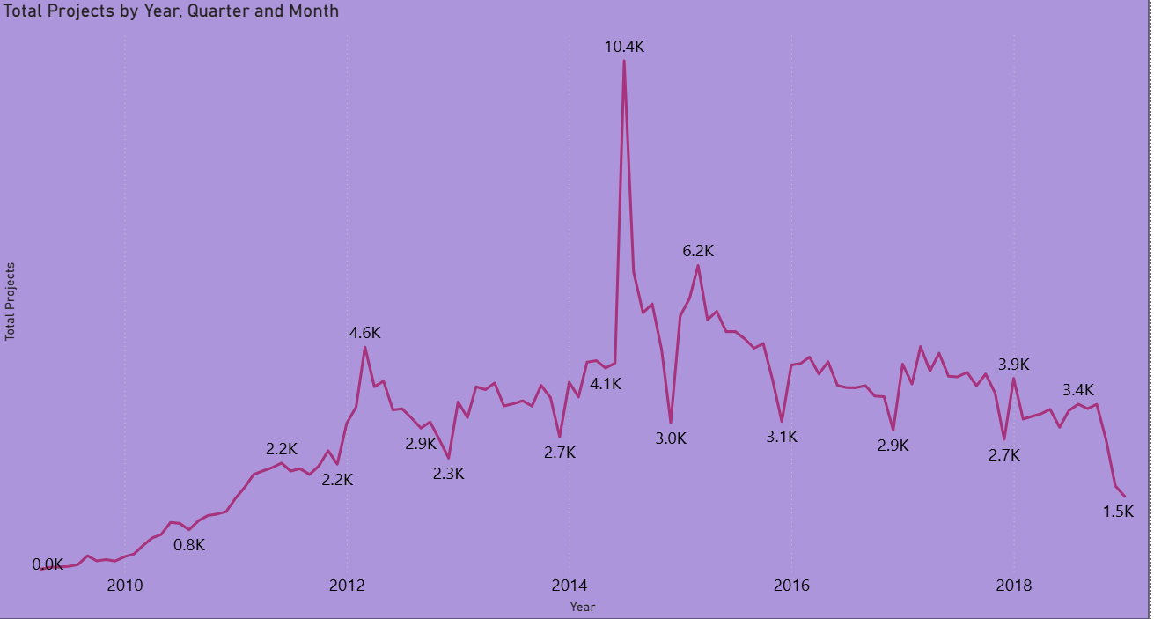
Total Projects By Category → Bar Chart
Games, Technology, and Design had the largest number of campaigns.
Smaller creative categories (Food, Art) were less represented.
Total Projects By Year/Quarter/Month → Line/Area Chart
Project launches grew steadily until 2015.
Activity peaked around 2015, then showed fluctuations by month and quarter.

Slide 11
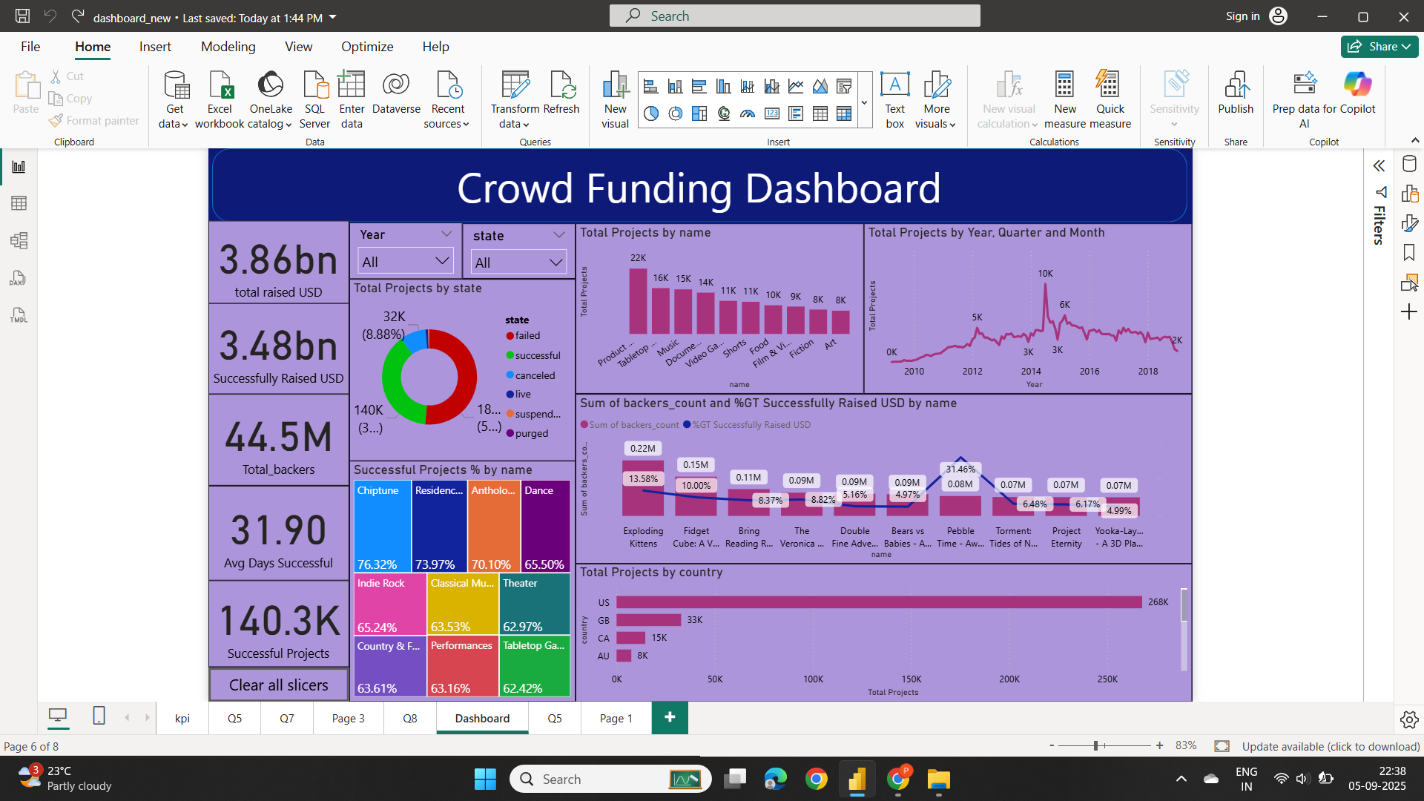
Successful projects
Average Duration (days)
About 140K campaigns reached their funding goals. That’s roughly 4 in 10 projects turning successful.
Amount Raised
Average campaign duration for success was ~32 days.
Most successful campaigns reached goals quickly.
Successful projects raised a combined total in the billions of USD.
Number of Backers
Over 40M backers supported successful campaigns overall.

Slide 12
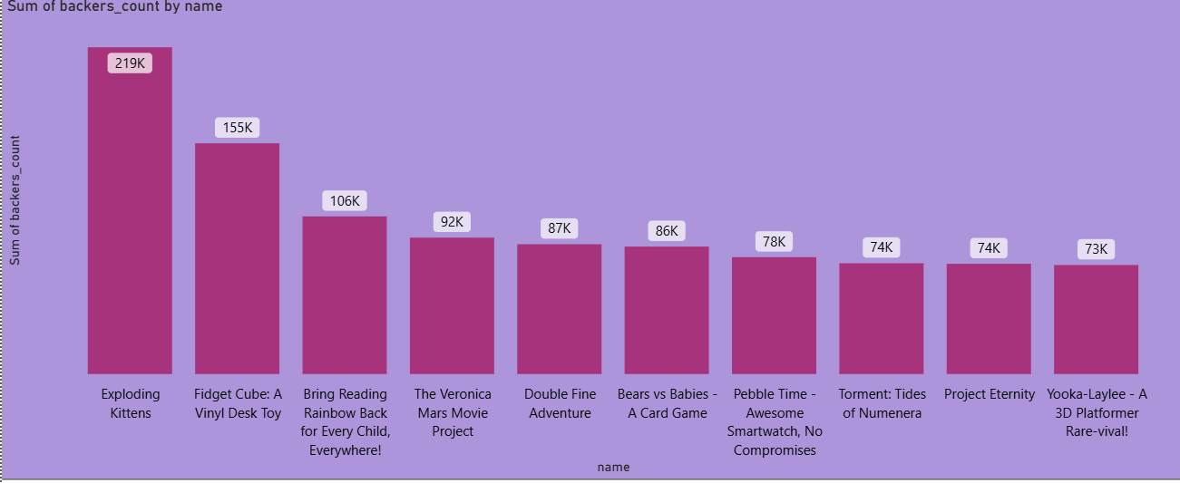
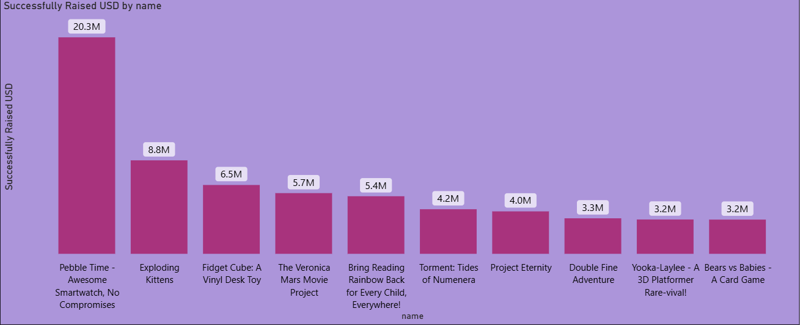
TOP SUCCESSFUL PROJECTS
By Number of Backers
Exploding Kittens led with 219K backers, far above the rest.
Projects with simple, fun concepts attracted the largest communities.
This shows a clear contrast: popularity (backers) ≠ revenue (funding).
By Amount Raised
Pebble Time dominated with $20.3M raised, more than double the next project.
High-tech innovations raised far more money, even with fewer backers.

Slide 13
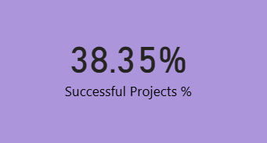
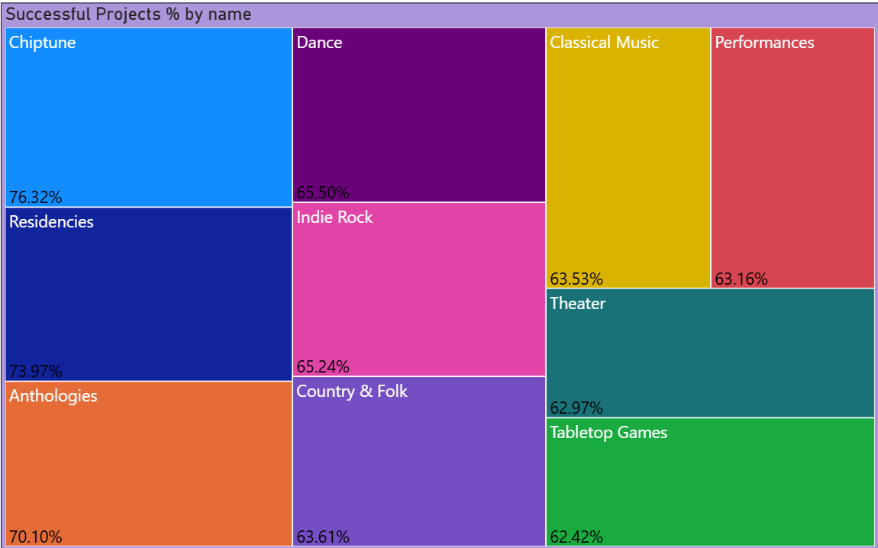
SUCCESS PERCENTAGE
Overall Success %
Overall success rate was below 40%.
The majority of projects failed to meet their goal
By Category
Music, Film, and Art had higher success percentages.
Tech and Games attracted more projects but had lower success rates

Slide 14
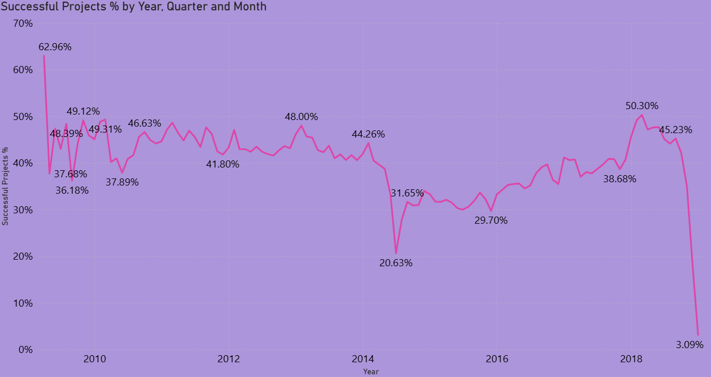
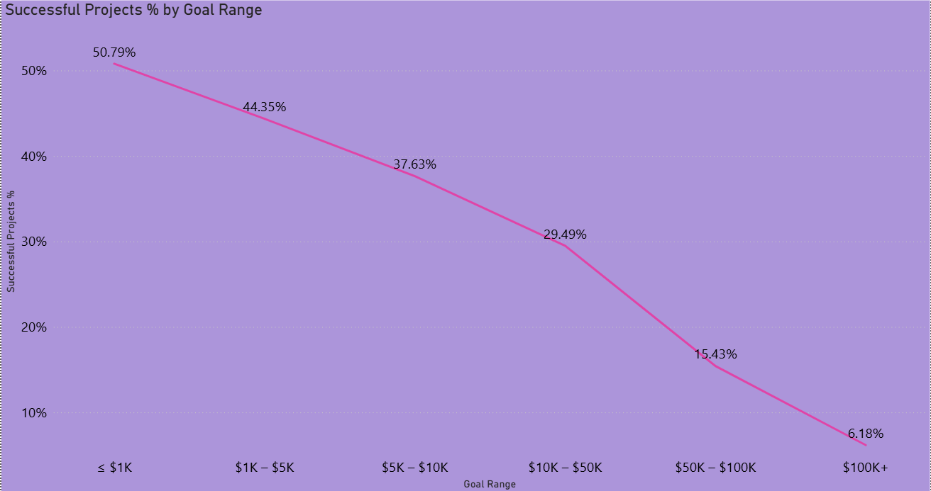
SUCCESS PERCENTAGE
By Year/Month
Success rates peaked in the early 2010s.
Monthly patterns showed seasonal spikes in performance
By Goal Range
Projects with goals under $10K had the highest success rates.
Large goal projects (>50K) struggled, with very low success chances

Slide 15
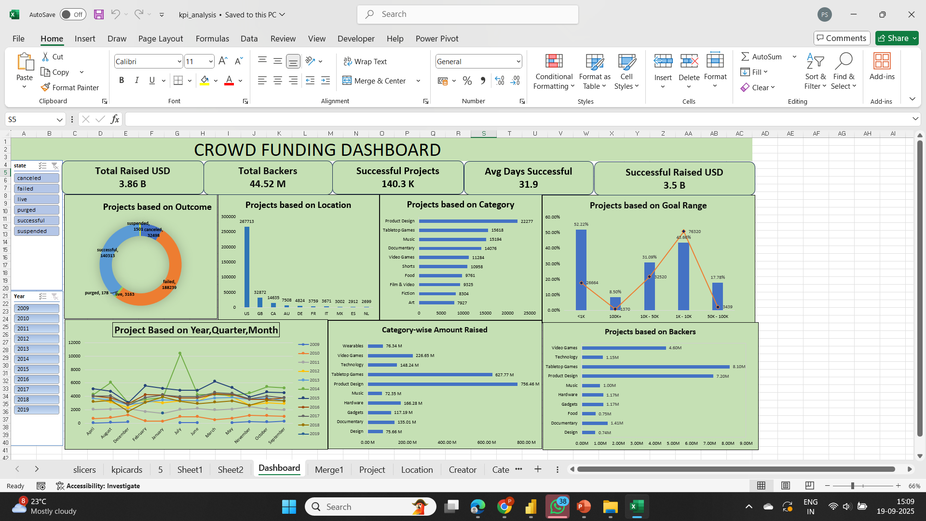
Excel Dashboard

Slide 16
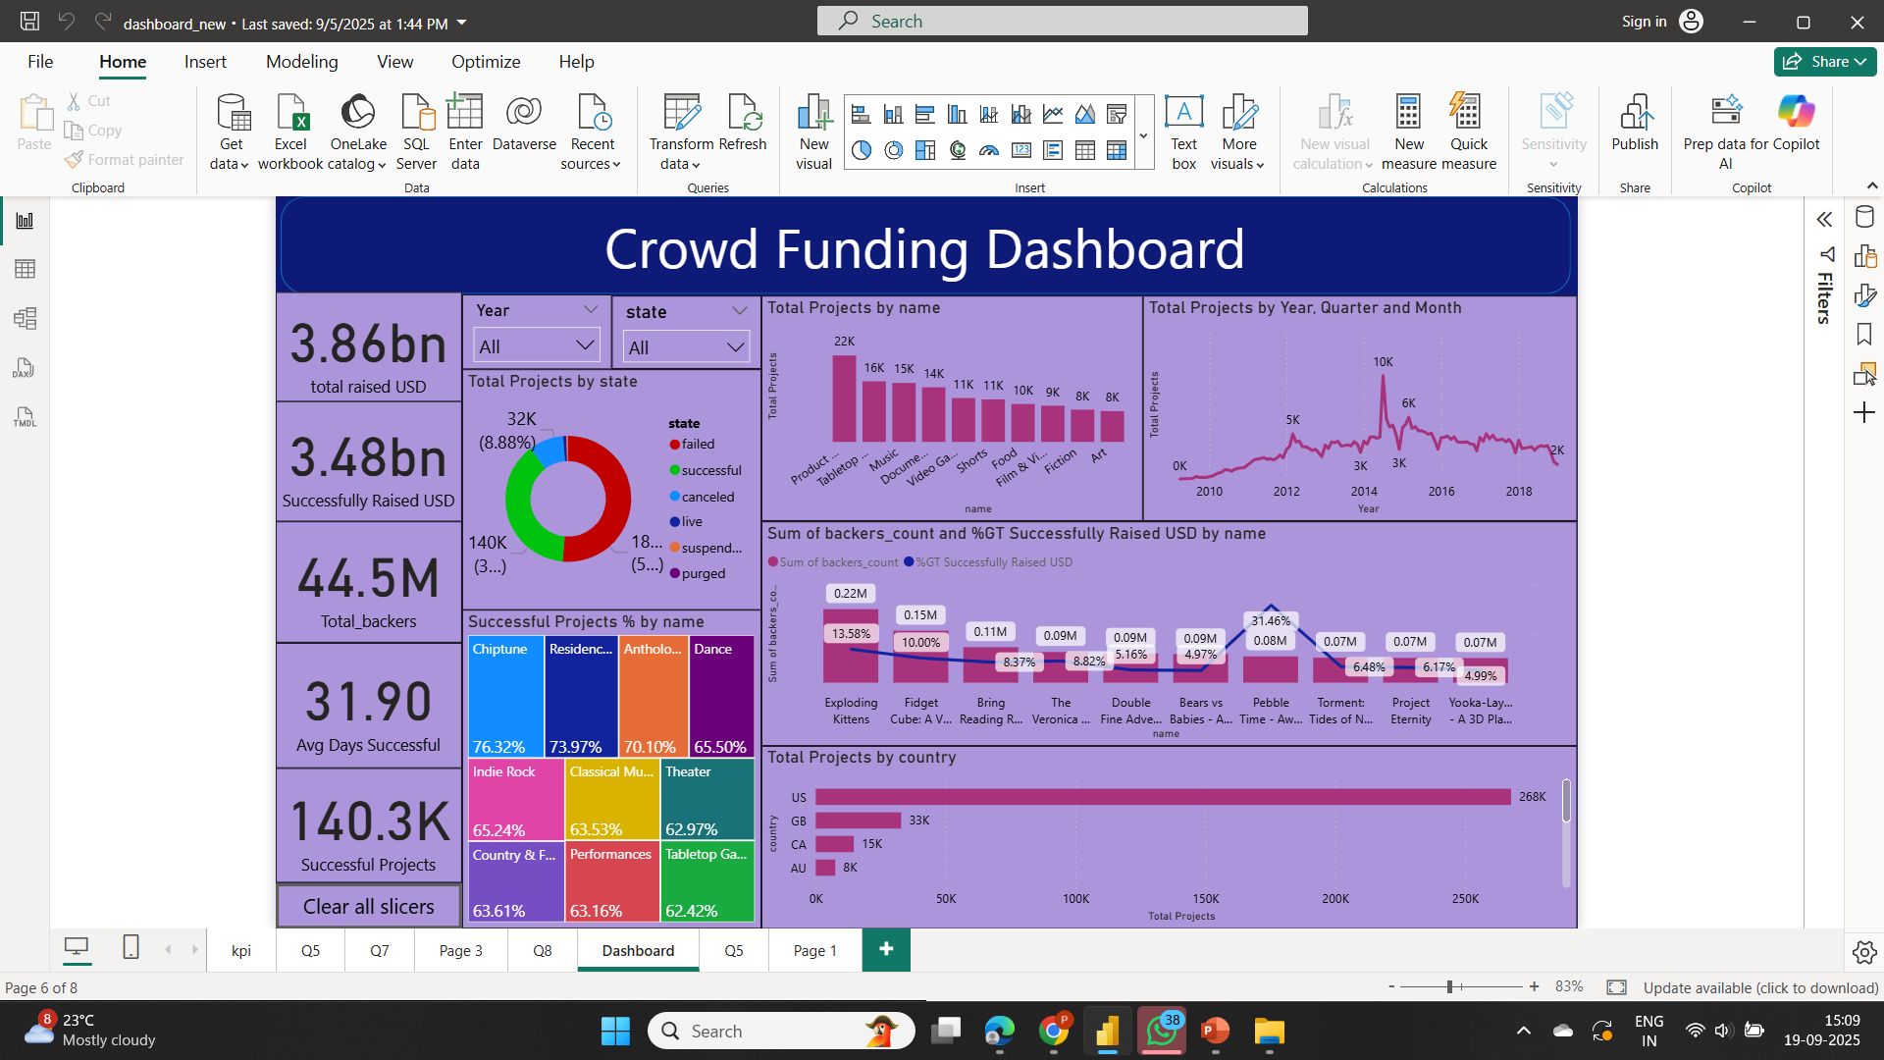
Power Bi Dashboard

Slide 17
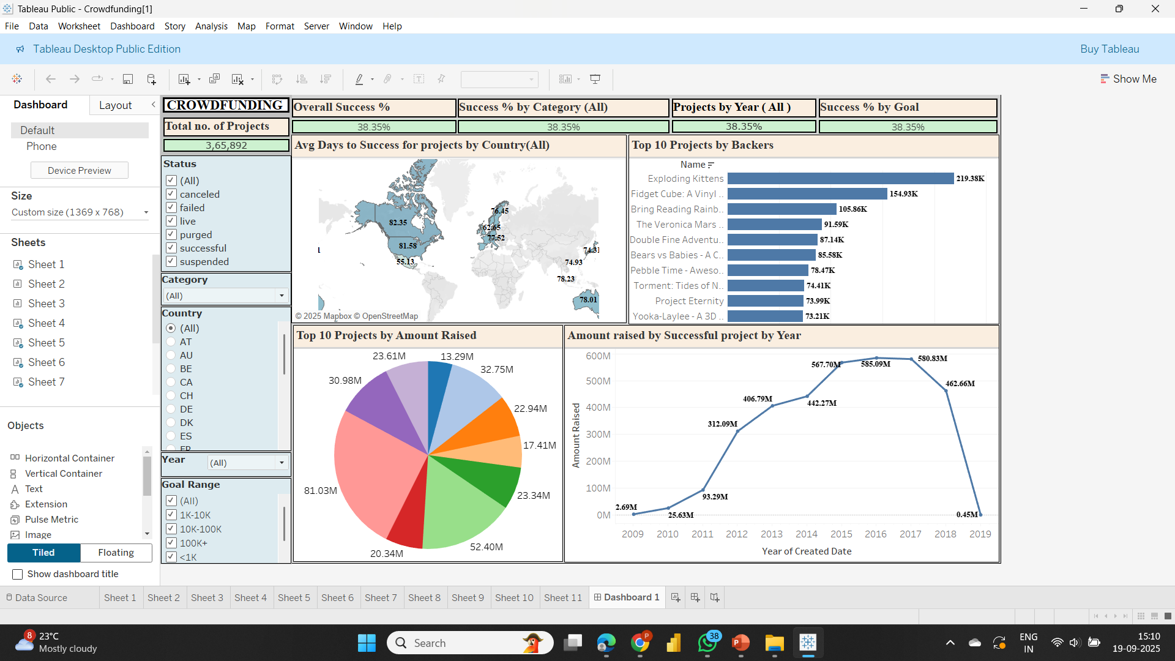
Tableau Dashboard

Slide 18
SQL Query
Crowd_funding_project_sql.sql

Slide 19
Key Takeaways
Crowdfunding projects show a high rate of failure, but the ones that succeed raise significant funds.
Geography and category strongly influence outcomes, with certain regions and creative fields performing better.
Smaller, realistic funding goals are more achievable and see higher success rates.
Community support plays a vital role, as some projects thrive on large numbers of backers, while others succeed with fewer but higher-value contributions.
Time and duration matter — shorter, well-timed campaigns perform more effectively.

Slide 20
Conclusion
The project highlights that crowdfunding is a powerful way to bring ideas to life, but success depends on several factors: setting achievable goals, choosing the right category, engaging communities, and managing campaign timelines effectively. By analyzing patterns across thousands of projects, we gain insights that can help creators design stronger campaigns and improve their chances of success.

Slide 21
Thank you

